Slide 1


Mobility in Cairo
November 2025
Abeer AbdelNaeem
MennaTullah Reda
Mohammad Hosny
Mostafa Nasr
Saeed Magdy
Supervised by: Dr. Amal Mahmoud

Slide 2
Table of Contents
Project Objectives
Project Methodology
Results and discussion
Recommendations

Slide 3
Project Objectives
The purpose of the project is two-fold:
The first fold: describing and comparing the consumption patterns of public and private modes of transportation, namely the metro and ride-hailing applications.
The second fold: discerning the different variables affecting said consumption patterns of the two modes of transportation and offering recommendations to increase the efficiency of the transportation network in the greater Cairo area and reduce its negative environmental impacts.

Slide 4
Project Methodology
Dataset overview
The dataset was an amalgamation of multiple datasets from multiple sources. The datasets were procured from the following websites:
https://cairometro.gov.eg
https://mpmr.gov.eg
https://www.statista.com/outlook/mmo/mobility/ride-hailing/egypt
https://www.povertyactionlab.org/evaluation/ride-hailing-services-increase-urban-mobility-egypt

Slide 5
Project Methodology
Dataset overview
The dataset contains 5 sheets, with the following numbers of rows, columns, and data types:
Sheet name | # of rows | # of columns | Types of data
Trips | 1000 | 10 | Numeric String Date and time
Customers | 200 | 6
Drivers | 100 | 6
Metro ridership | 4053 | 3
Fuel prices | 20 | 4 | Numeric Date and time

Slide 6
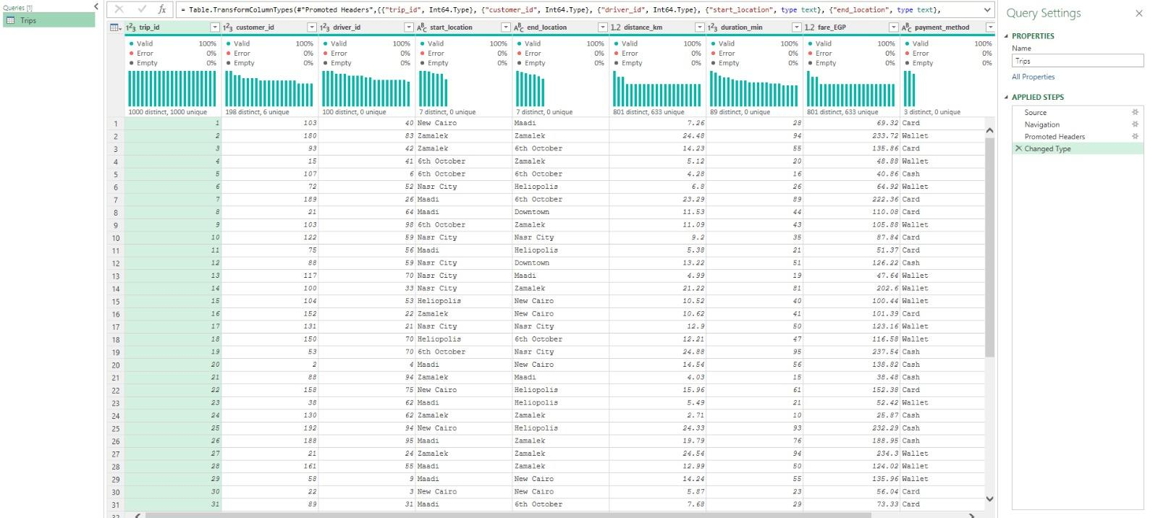
Project Methodology
Dataset before pre-processing | Excel

Slide 7
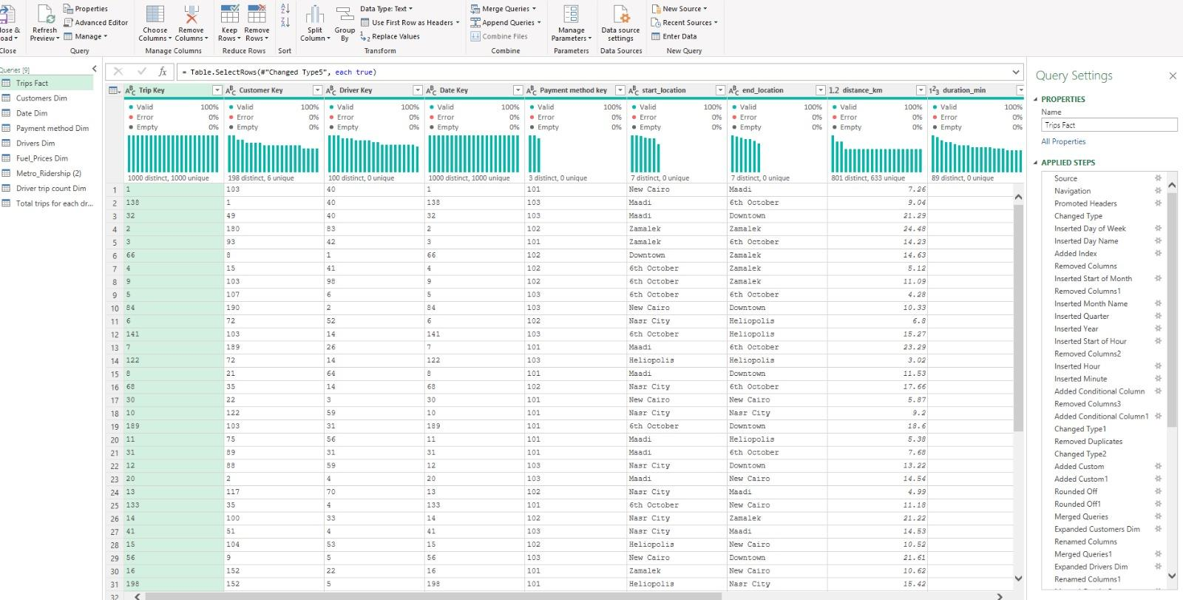
Project Methodology - Cont’d
Dataset after pre-processing | Excel

Slide 8
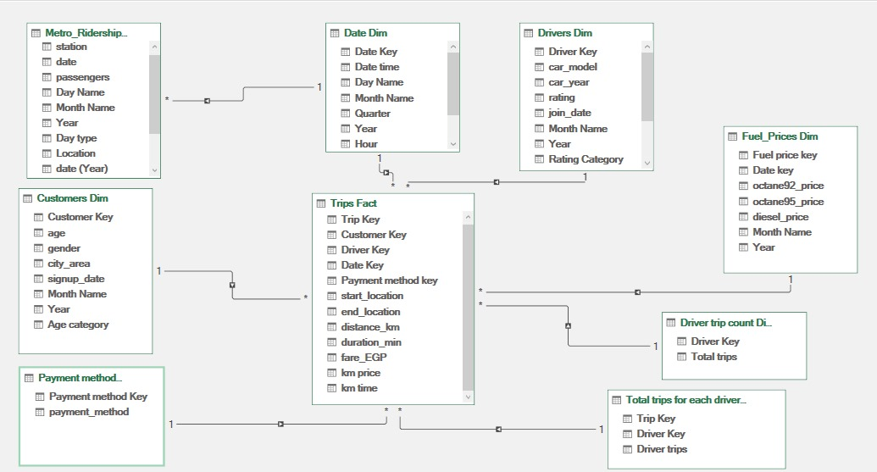
Project Methodology - Cont’d
Data modelling | Excel

Slide 9
Project Methodology - Cont’d
Data modelling | Excel

Slide 10
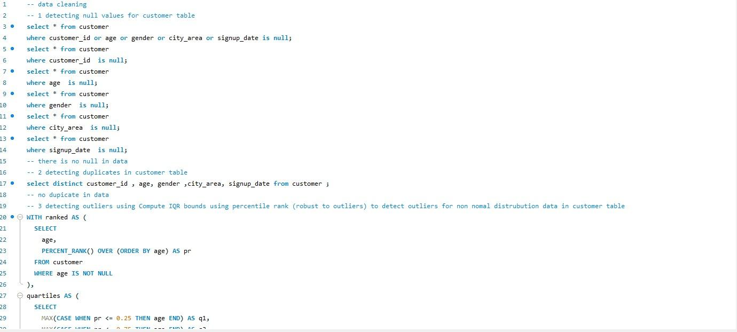
Project Methodology
Dataset Preprocessing | SQL

Slide 11
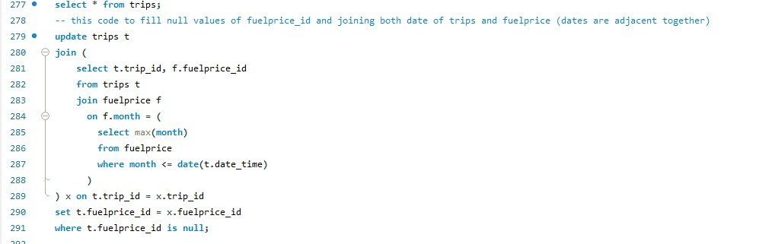
Project Methodology
Dataset Preprocessing | SQL

Slide 12
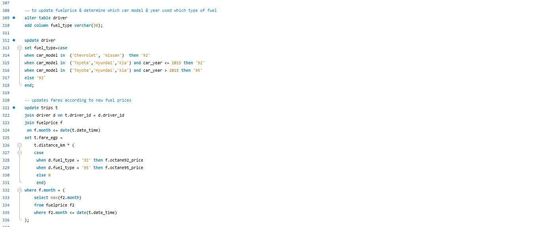
Project Methodology
Dataset Preprocessing | SQL

Slide 13
Project Methodology
Dataset Preprocessing | SQL

Slide 14
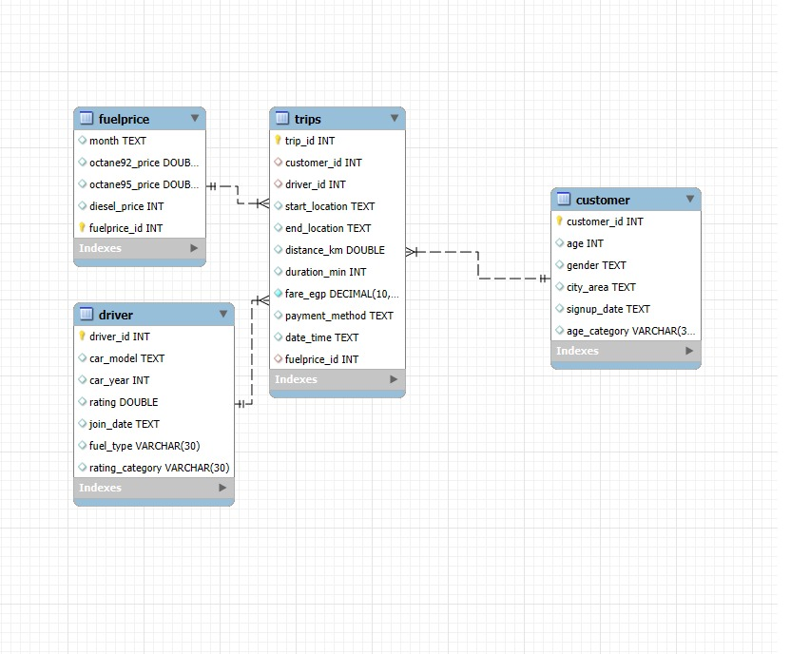
Project Methodology
Data Modelling | SQL

Slide 15
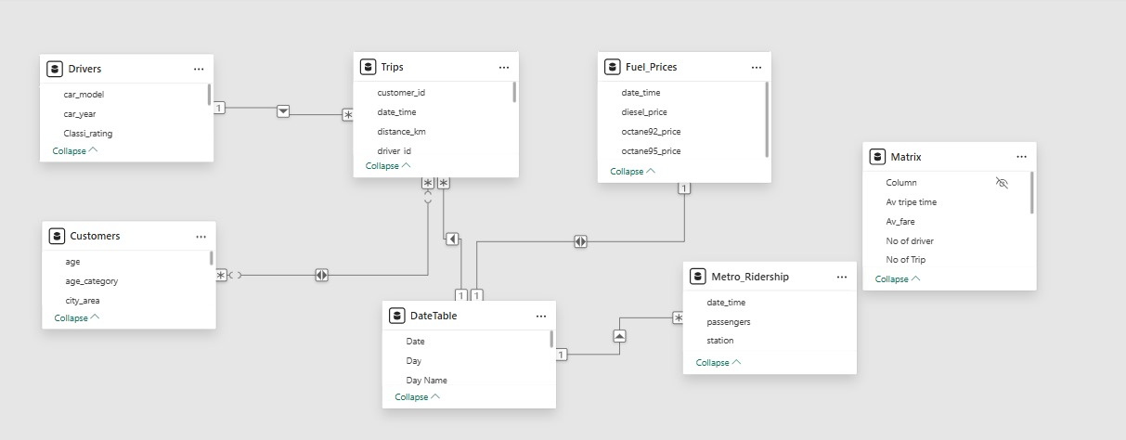
Project Methodology - Cont’d
Data modelling | Power BI

Slide 16
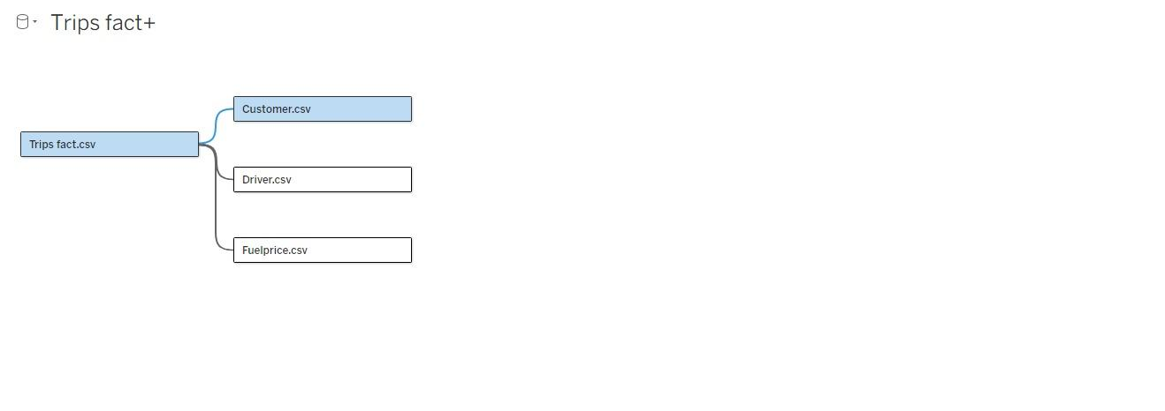
Project Methodology - Cont’d
Data modelling | Tableau

Slide 17
Project Methodology - Cont’d
Data modelling | Tableau

Slide 18
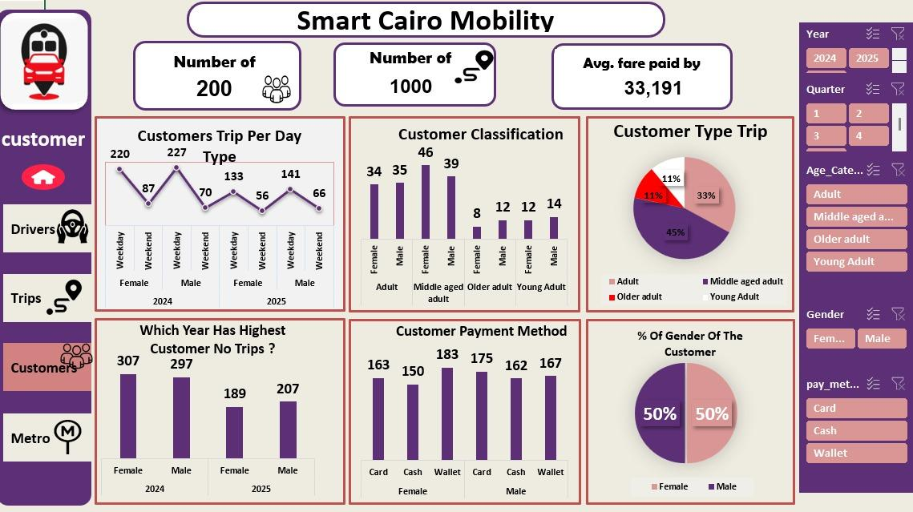
Project Methodology
Data analysis | Excel overview - Cont’d

Slide 19
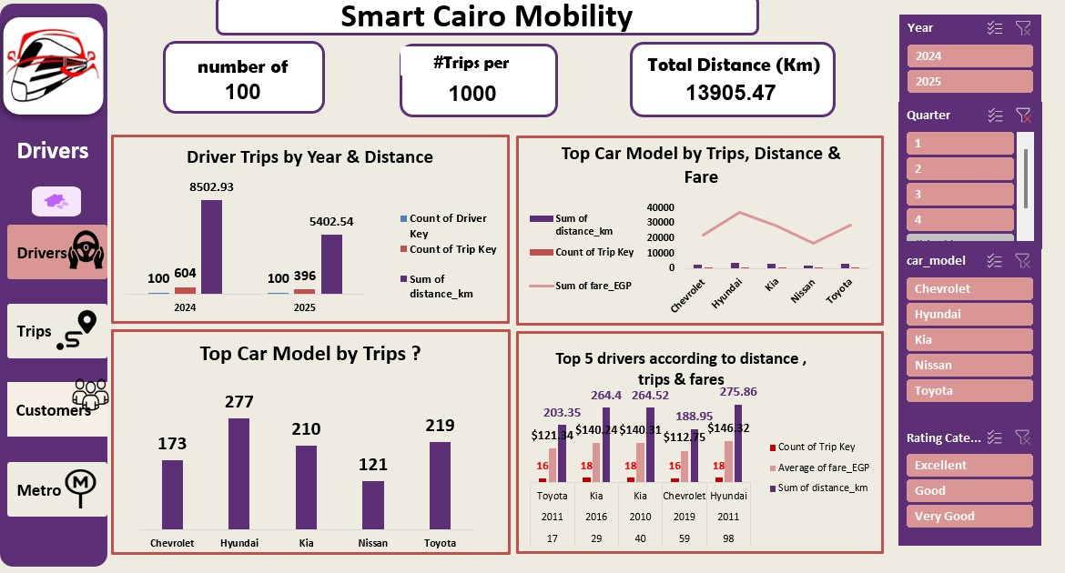
Project Methodology
Data analysis | Excel overview - Cont’d

Slide 20
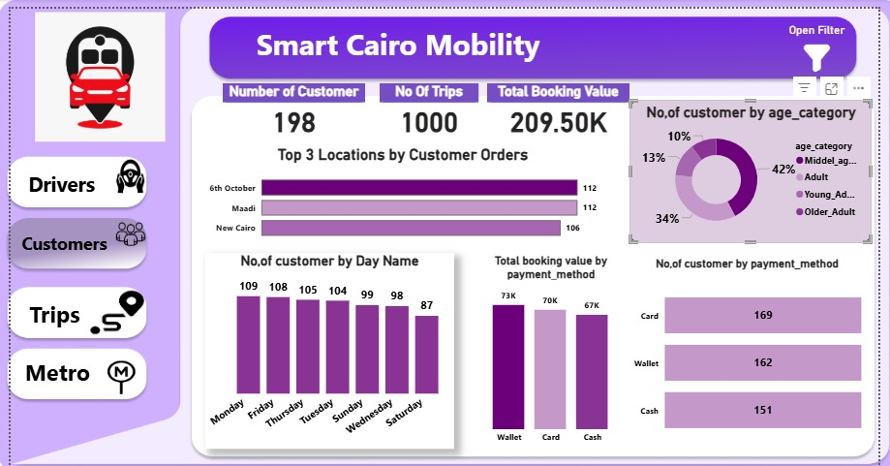
Project Methodology
Data analysis | Power BI overview

Slide 21
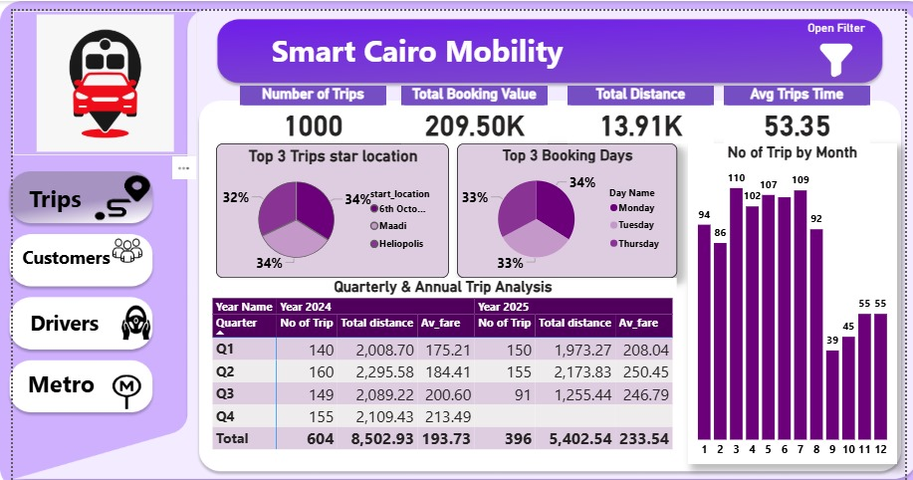
Project Methodology
Data analysis | Power BI overview

Slide 22
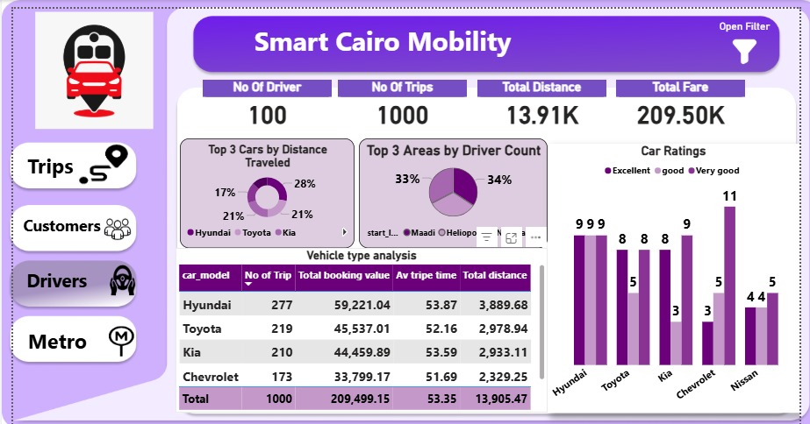
Project Methodology -
Data analysis | Power BI overview

Slide 23
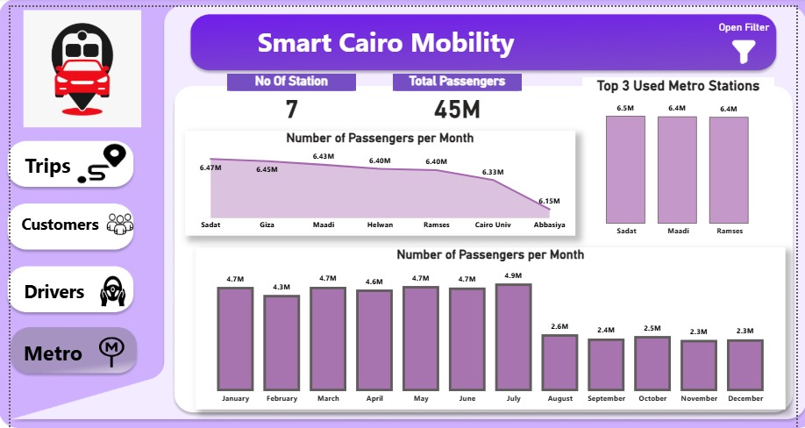
Project Methodology
Data analysis | Power BI overview - Cont’d

Slide 24
Project Methodology
Data analysis | Power BI overview - Cont’d

Slide 25
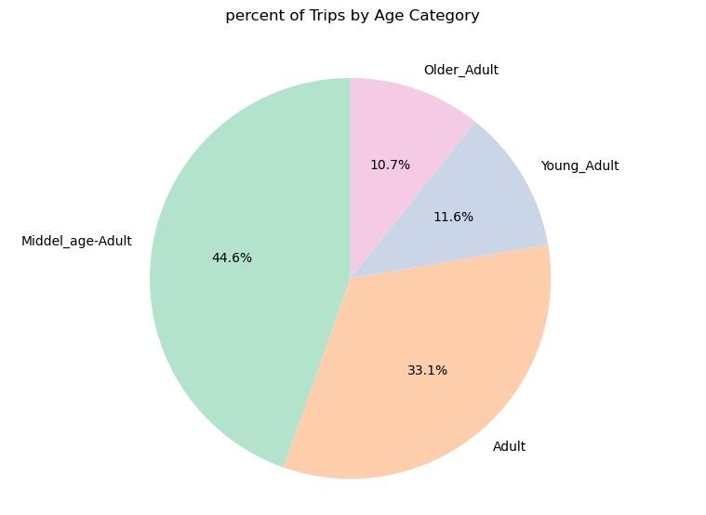
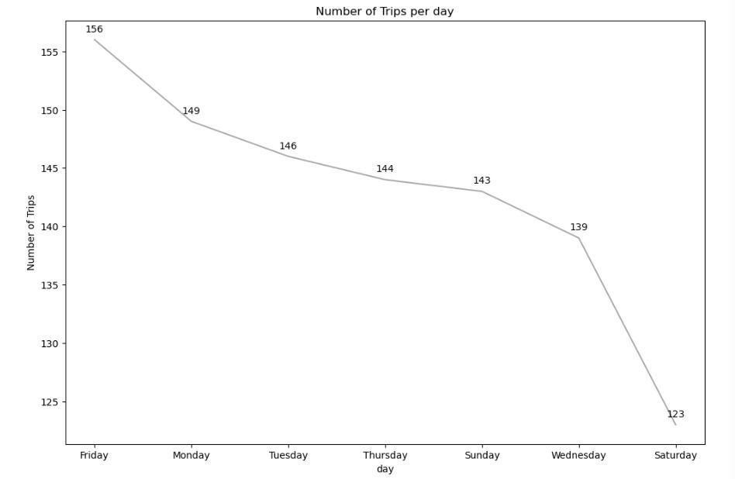
Project Methodology
Data analysis | Python overview

Slide 26
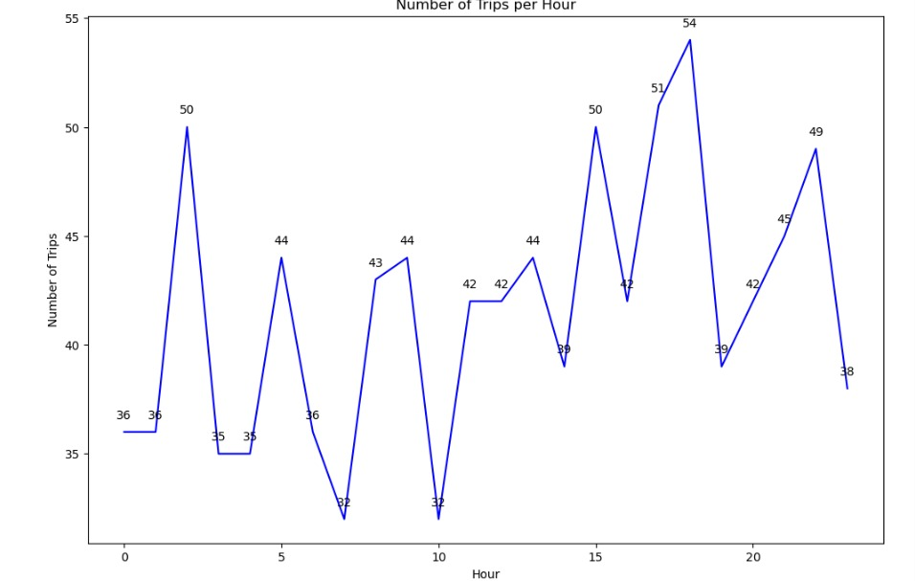
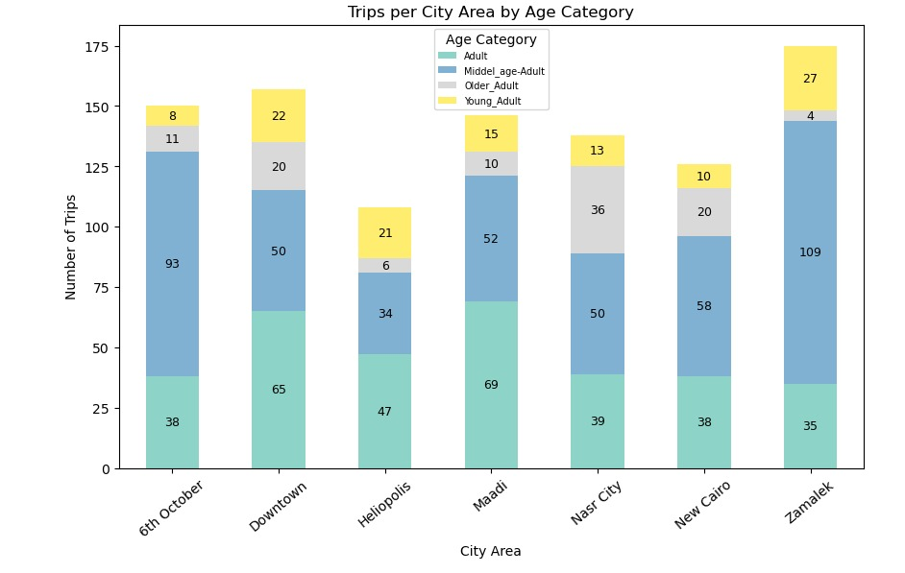
Project Methodology
Data analysis | Python overview - Cont’d

Slide 27
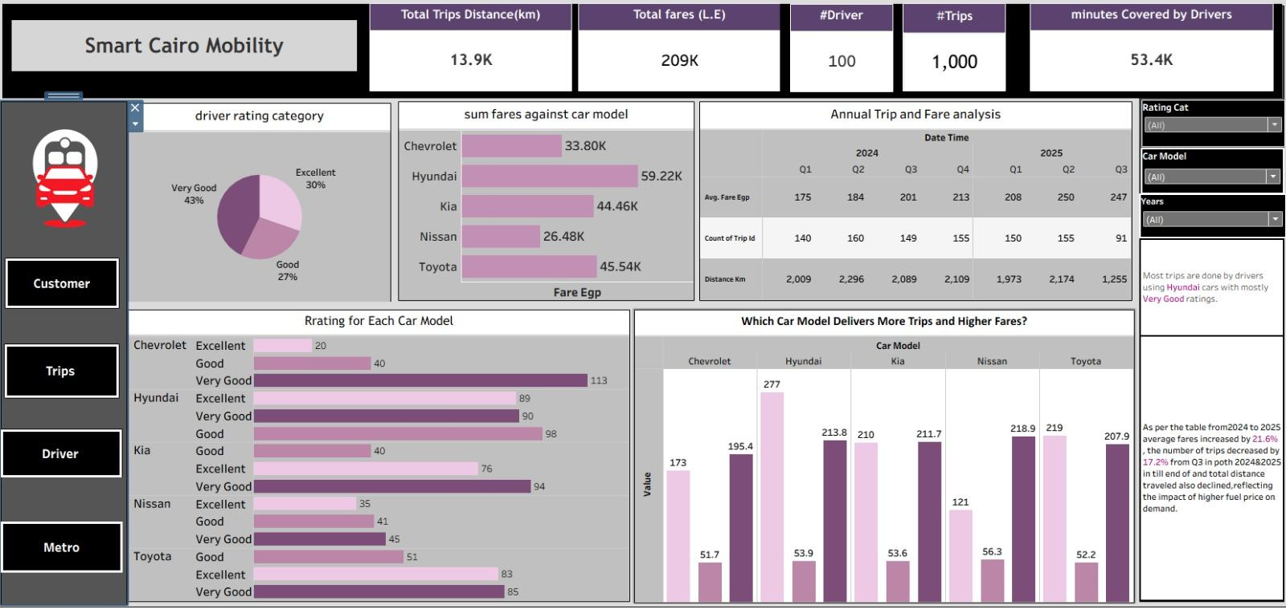
Project Methodology
Data analysis | Tableau overview

Slide 28
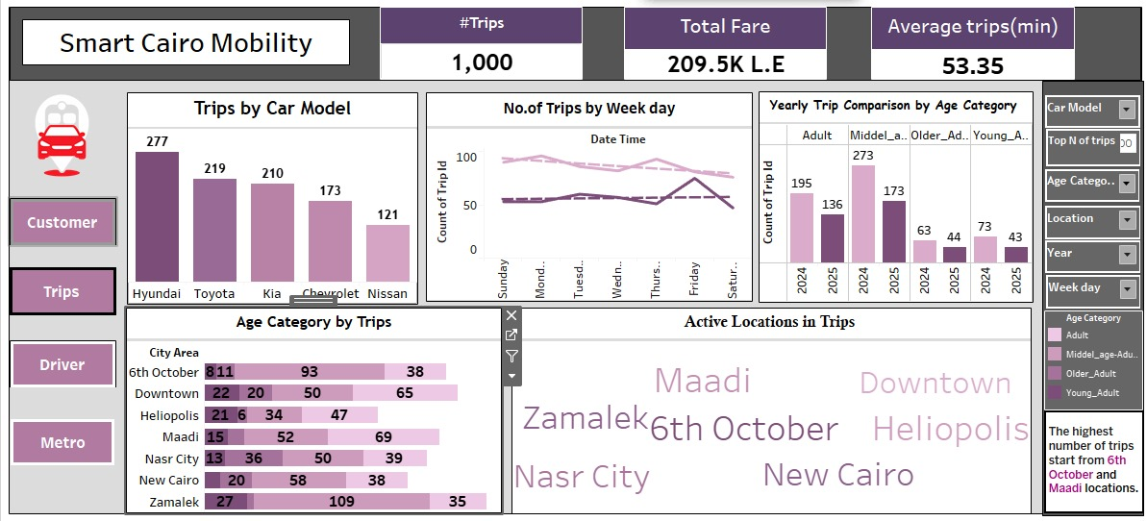
Project Methodology
Data analysis | Tableau overview - Cont’d

Slide 29
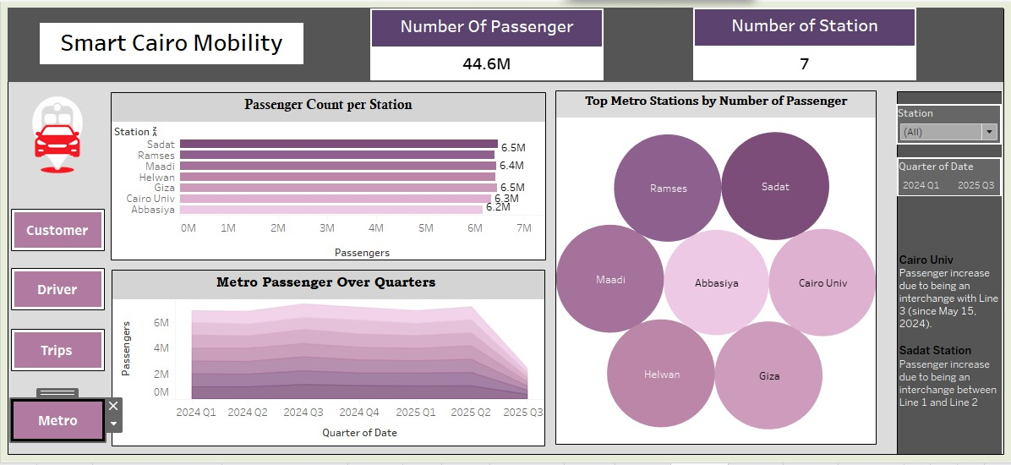
Project Methodology
Data analysis | Tableau overview - Cont’d

Slide 30
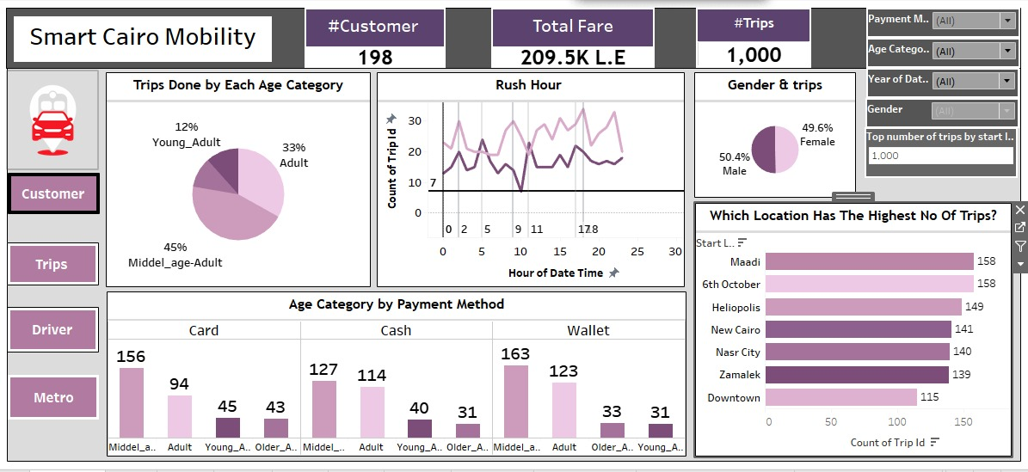
Project Methodology
Data analysis | Tableau overview - Cont’d

Slide 31
Results and discussion
Key insights | Trips
Average duration of trips: 53 minutes
In 2024, the day with the highest number of trips was Monday, with 96 trips, whereas during the first three quarters in 2025, the day with the highest number of trips was Friday, with 75 trips
In 2024, the rush hour was 6 pm, with a total of 34 trips, and in the first three quarters of 2025, the rush hour was 5 am, with a total of 24 trips
The most frequent points of departure were the 6th of October and Maadi

Slide 32
Results and discussion
Key insights | Trips - Cont’d
The sum of fares in 2024 and the first three quarters of 2025 was EGP 209.5K
In the first three quarters of 2024, the sum of fares was EGP 76K, attained through 494 trips, whereas in the first three quarters of 2025, the sum of fares was EGP 92K, attained through 396 trips
The reason for the increase in fares in 2025, despite the decrease in the number of trips is the several rounds of increases in fuel prices, suggesting that consumers chose alternative, cheaper modes of transportation.

Slide 33
Results and discussion
Key insights | Customers
The customer base for the ride-hailing app had an equal split of males and females
The customer base was divided into 4 age groups, as follows:
12% were young adults
33% were adults
45% were middle-aged citizens
11% were senior citizens
The most frequently used payment method was electronic payments, used 688 times, whereas cash payment was used 312 times

Slide 34
Results and discussion
43% of the drivers received Very Good rating, 30% of the drivers received Excellent rating, and 27% received Good rating
The most frequently used car model for the trips was Hyundai, which completed 277 trips, and earned EGP 59K in fares, whereas the least frequently used car model was Nissan, which completed 121 trips, and earned EGP 26K in fares
Key insights | Drivers

Slide 35
Results and discussion
The dataset covered 7 metro stations across the Greater Cairo metropolis
The total number of passengers in 2024 and the first three quarters in 2025 in these stations was 44M
The average number of passengers starting their commute from these stations during weekdays was 4.5M, whereas during the weekends, an 85% drop was observed, since the average number of passengers was 1.8M
Key insights | Metro ridership

Slide 36
Results and discussion
The metro station with the highest numbers of passengers is Sadat station with a total of 6.4M
It is worth noting that in Q4 2024, the Cairo University station had the highest number of passengers with a total of 1.08M passengers due to the launch of the second phase of Line 3, which contributed to greater connectivity between the east and west of Cairo
Key insights | Metro ridership - Cont’d

Slide 37
Recommendations
Relying on the metro during peak traffic congestion times - around of the end of the workday - to avoid higher fares and waste of time
Opting for ride-hailing apps during the weekend to make the most out of less congested roads, and subsequently, benefit from lower fares
For customers

Slide 38
Recommendations
Prioritizing the recruitment of drivers with newer car models for more efficient fuel consumption that would result in more competitive fares
Promoting pick-ups close to metro stations so that drivers fill in the urban gaps between metro stations
For ride-hailing companies

Slide 39
Recommendations
Fostering collaborations between the National Authority for Management and Operations of the Metro and local municipalities to increase the accessibility and walkability of streets surrounding metro stations to encourage more citizens to use them
For policymakers

